Slide 1
Annual Interagency Accessibility Forum
Unlocking the Power of Accessibility
October 11-13, 2022
Section 508 PMs: What You Need To Know
Angela Watkins (PBGC) and Gary Morin (NIH NCI) Show You Their Way

Slide 2
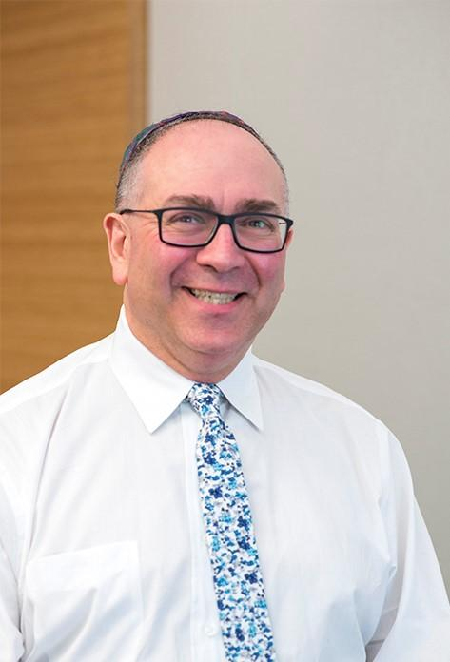
Gary M. Morin, Section 508 Coordinator
I am…
NIH National Cancer Institute
NCI Office of Communications and Public Liaison (OCPL)
NCI Shady Grove Campus, Room 2E-568
9609 Medical Center Drive
Rockville, MD 20850
(240) 276-6920
NCI Section 508 Coordinator NCI508@mail.nih.gov
Gary Morin (NIH/NCI) MorinG@mail.nih.gov
NCI Home Page for Section 508 Guidance
Section 508: Accessibility at NIH
Section 508: Accessibility @ HHS
HHS Policy for Section 508 Compliance and Accessibility of Information and Communications Technology (ICT)

Slide 3
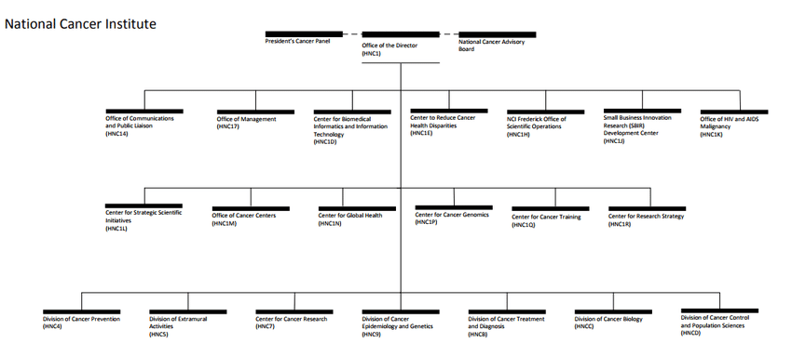
My role as a Section 508 Program Manager – Gary Morin
NCI Internal Communications
NCI External Communications
NCI Software Systems and Applications
NCI Acquisitions and Contracts

Slide 4

Gary and the National Cancer Institute
Department of Health & Human Services (HHS)
National Institutes of Health (NIH)
National Cancer Institute (NCI)
HHS: 11 agencies or Operating Divisions
NIH: 27 Institutes and Center
NCI: Principal agency for cancer research and training

Slide 5
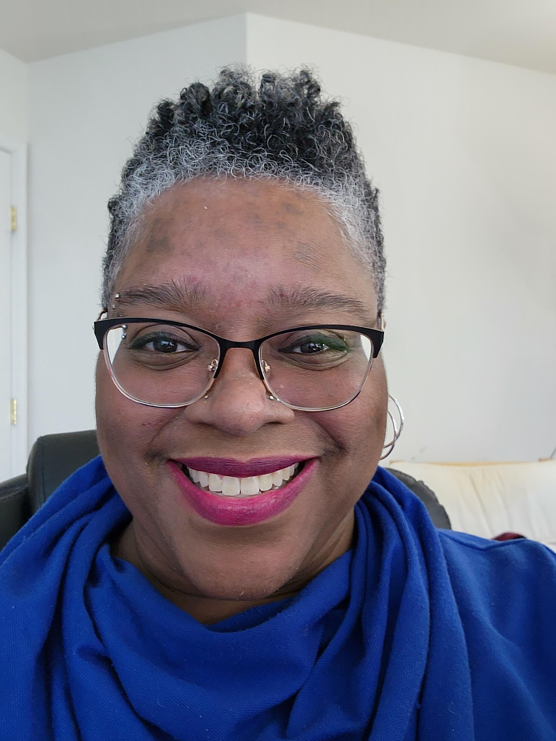
Angela Watkins, Section 508 Program Manager
I am…
Pension Benefit Guaranty Corporation (PBGC)
Office of Information Technology
Enterprise Governance Department, Policy Compliance Division
445 12th Street SW
Washington DC 20024
(202) 229-3188
Section 508 Program Manager
Angela Watkins email: watkins.angela@pbgc.gov

Slide 6
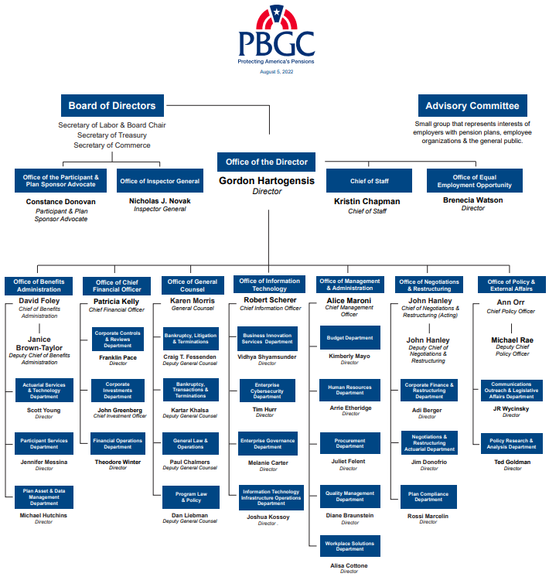
My role as a Section 508 Program Manager – Angela Watkins
Pension Benefit Guaranty Corporation (PBGC)
PBGC was created by the Employee Retirement Income Security Act (ERISA) of 1974
Ranked #1 in the Small Agency Category as “Best Places to Work in the Federal Government for 2021”

Slide 7
Let’s Take a Poll (#1)
Who’s here with us?
Provide your answer (via letter):
a. Program Manager/Coordinator
b. Team member
c. Champion
d. Content owner or program staff
e. Acquisitions, Procurement, Contracts
f. Executive

Slide 8
The Playbook is a Guide -
You’re not expected to know all the plays
Or use them in a specific order
They work in the best order for your environment
The Playbook - When & Where to Use It
Match your skillset to the play
Contain it
Absorb it
Use it to pace yourself
Notes:
Speaker Gary (NIH):

Slide 9
Links to the Section 508 Playbook
Play 1: Establish a Section 508 Program Manager to lead compliance efforts
Play 2: Assess your Section 508 program maturity
Play 3: Develop a Section 508 Accessibility Roadmap
Play 4: Establish a Section 508 Policy
Play 5: Develop a Section 508 Program Team
Play 6: Collaborate with the federal accessibility community
Play 7: Integrate accessibility needs into requirements and design processes
Play 8: Integrate accessibility needs into market research and acquisition processes
Play 9: Integrate accessibility needs into development processes
Play 10: Conduct Section 508 testing
Play 11: Track and resolve accessibility issues
Play 12: Educate the workforce
Notes:
https://www.section508.gov/tools/playbooks/technology-accessibility-playbook-intro/

Slide 10
Which Plays Work Best For You: Gary
Plays You Like
Plays Do You Need To Prep For
Plays You Adapt Quickly To
Play 12: Educate the workforce
Play 4: Establish a Section 508 Policy
Play 8: Integrate accessibility needs into market research and acquisition processes
Play 6: Collaborate with the federal accessibility community
Play 5: Develop a Section 508 Program Team
Notes:
Speaker: Gary (NIH)

Slide 11
Which Plays Work Best For You: Angela
Plays You Like
Plays Do You Need To Prep For
Plays You Adapt Quickly To
Play 5: Develop a Section 508 Program Team
Play 12: Educate the workforce
Play 6: Collaborate with the federal accessibility community
Play 11: Track and resolve accessibility issues
Play 2: Assess your Section 508 program maturity
Play 4: Establish a Section 508 Policy
Notes:
Speaker: Angela (PBGC)

Slide 12
Let’s Take a Poll (#2)
Which of the twelve Program Manager Plays is the most important?
Provide your answer: 1-12
Do the twelve plays need to be played in order?
Provide your answer: Yes/No
Notes:
These are trick questions

Slide 13
We All Wear a Uniform
We’re All Here to Win the Best Way Possible
Let’s define “winning”
Notes:
Speakers: both Gary and Angela

Slide 14
Communication
It’s not always linear
Cultivating Relationships
Authority by Reputation – and what that means
Notes:
Speakers: Gary and Angela

Slide 15
Communication – What It Really Looks Like
Communications via “Expected Hierarchy”
Communications via Actual Relationships
Executives
Executives
Department Director
Department Director
Department Heads
Department Heads
Scientist
Division Manager
Scientist
Division Manager
Divisions/Roles
Divisions/Roles
Section 508
Security
Privacy
Section 508
Security
Privacy
Notes:
The animation is targeted for Communications via Actual Relationships to demonstrate it really isn’t linear.

Slide 16
When the Play Goes Wrong
How do we recover
How to educate and not offend and stay in the game
Notes:
Speakers: Gary & Angela

Slide 17
Playing Your Best Game
Prep Yourself
Prep Others
Learn From Every Play
Celebrate Every Win
Notes:
Summary Message and Take a ways

Slide 18
Let’s Take a Poll (#3)
How do you see your role/position
Provide your answer (via letter):
a. Coach (directing the plays)
b. On the field (In the Game - regardless of the position)
c. Cheerleader (cheering others from the Sidelines)
d. Team Owner 😊 (working to fill the other roles)
e. Referee (watching to make sure everyone is playing fair - blowing the whistle when they’re not)

Slide 19
Get in the Game with the Best Plays That Work For You
Play 1: Establish a Section 508 Program Manager to lead compliance efforts
Play 2: Assess your Section 508 program maturity
Play 3: Develop a Section 508 Accessibility Roadmap
Play 4: Establish a Section 508 Policy
Play 5: Develop a Section 508 Program Team
Play 6: Collaborate with the federal accessibility community
Play 7: Integrate accessibility needs into requirements and design processes
Play 8: Integrate accessibility needs into market research and acquisition processes
Play 9: Integrate accessibility needs into development processes
Play 10: Conduct Section 508 testing
Play 11: Track and resolve accessibility issues
Play 12: Educate the workforce
Notes:
https://www.section508.gov/tools/playbooks/technology-accessibility-playbook-intro/

Slide 20
Q&A in Next Session
After a short commercial break, we’ll be available for questions

Slide 21
Resource Information
Strategic Plan: Improving Management of Section 508 of the Rehabilitation Act (2013)
21st Century Integrated Digital Experience Act – Digital.gov (2018); H.R.5759 - 115th Congress (2017-2018): 21st Century Integrated Digital Experience Act | Congress.gov | Library of Congress
Executive Order on Diversity, Equity, Inclusion, and Accessibility in the Federal Workforce - The White House (2021 06 25)
Accessible Federal Technology for People with Disabilities, Older Americans, and Veterans (2022)
Hearings to examine accessible Federal technology for people with disabilities, older Americans, and veterans. | Congress.gov | Library of Congress (2022)

Slide 22
Resource Information (continued)
Listservs, such as Digital.gov Communities of Practice – Digital.gov and IT Accessibility - EDUCAUSE Connect
Accessibility Training, Tools, and Events | Section508.gov
Courses that cover various aspect of Section 508 compliance and best practices
Conformance for Documents, Presentations, PDFs, and more
IAAP | International Association of Accessibility Professionals (accessibilityassociation.org)
Course List: Digital Accessibility Education, Training, and Certification (Web Accessibility Initiative (WAI) | W3C)

